Slide 1
The G.O.A.T VOTER APP
The G.O.A.T VOTER APP
TEAM 4:
Richard Bunnicelli
Ghislaine Georges
Mohammed Islam
Sulai Sivadel

Slide 2
Purpose of The GOAT Voter App
To increase voter participation;
To make information about voting, and candidates easily accessible;
To offer a one-stop shop platform where users can access information about candidates anywhere in the United States.

Slide 3
Steps Taken To Build The App
Brainstormed
Decided on a problem to focus on
Selected the App name
Divided the tasks

Slide 4
Apps Used
Front End:
Handlebars
Bootstrap
CSS
Parallax
Deployment:
Heroku
Google Domain (www.goatvoter.org)
https://docs.google.com/spreadsheets/d/11XD-WNjtNo3QMrGhDsiZH9qZ4N8RYmfpszJOZ_qH1g8/edit#gid=0
Back End:
Node.js
Mysql
Express
Sequelize
Voyager
Google Civic Api
JSON

Slide 5
SHOW TIME!
How Does The GOAT Voter App Work?

Slide 6
Challenges Faced Building The App
No available/incomplete data about candidates

Slide 7
Features To Be Added In The Future
Up-to-date information about candidates for all states, not only for incumbents already in office.
Option to request free transportation to get to get to polling sites on election day.

Slide 8
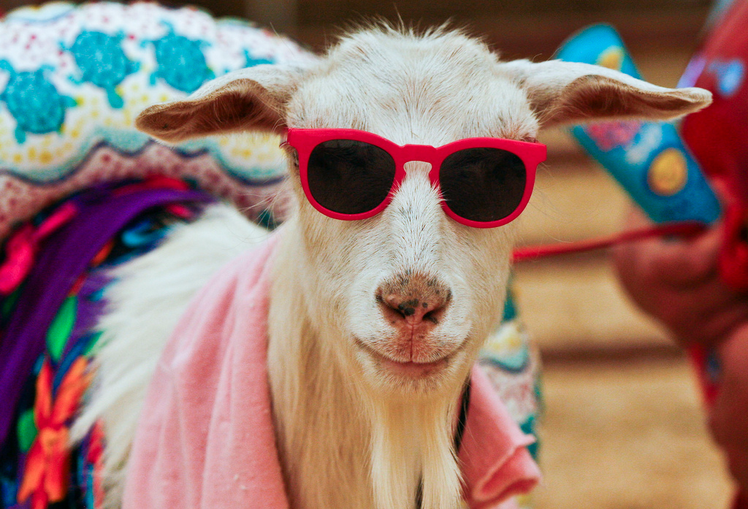
Q & A
www.goatvoter.org

